Slide 1
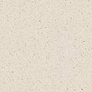

Lane Detection
Md Irshad Alam
Semester - VII
Roll No - 17BCS073
Abhay Kumar Gupta
Semester - VII
Roll No – 17BCS067

Slide 2
What?
In this project, we will use python and OpenCV to detect the lanes lines on the road.
We will develop a processing pipeline that will work on list of images and we will apply the result on video input.
Processing pipeline will produce output corresponding given input which we will make use of.

Slide 3
Motivation
Using lane detection technique, we can detect the lane without prior knowledge of the road geometry.
Detecting lanes play important role in developing intelligent vehicles.
Avoiding road accidents.
Assists driver in changing lane.
Application in self driving vehicles.

Slide 4
How?
Loading input images
Color Space selection
Canny Edge Detection
Grey scaling the images
Applying Gaussian smoothing
Apply Canny Edge Detection
Determine region of Interest
Hough transformation
Average and Extrapolate the lane lines
Apply pipeline on video input

Slide 5
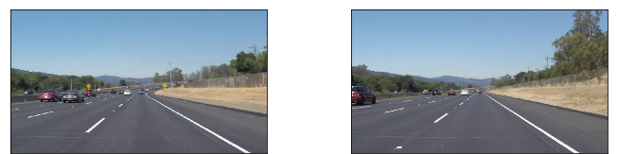
Loading test input
We will take series of individual images as input.

Slide 6
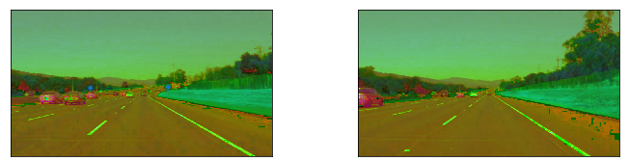
Color Space Selection & Masking
We need to select the most suitable color space.
It may be RGB, HSV, or HSL.
It is found that HSL is most suited.
we will try to retain the as much of the lane lines possible, while blacking out most other stuff.
We will achieve this by using mask image which will black out everything except yellow and white lane lines.

Slide 7
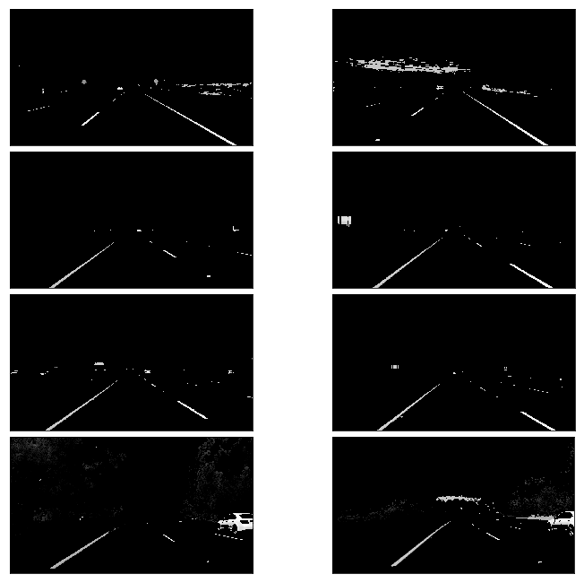
Canny Edge Detection
Gray scaling the images
Original input images contains three channel.
It is very difficult to handle three channel.
So, we convert the image to Gray scale.
2. Gaussian smoothing
In original input images noise is obvious.
Which may result in unwanted edges.
So, we filter out those noises using Gaussian filter.

Slide 8
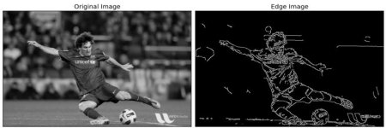

Canny Edge Detection
Applying Canny Edge detection
Finding Intensity gradient of images
G is edge gradient of particular pixel of the image
Hysteresis Thresholding
If an edge pixel’s gradient value is higher than the high threshold value, it is marked as a strong edge pixel.
If an edge pixel’s gradient value is smaller than the high threshold value and larger than the low threshold value, it is marked as a weak edge pixel.
If an edge pixel's value is smaller than the low threshold value, it will be suppressed.
The two threshold values are empirically determined and their definition will depend on the content of a given input image.

Slide 9
Determining region of interests.
We are only interested in areas where lanes lines are found.
So, we will make a mask and will cut those unwanted areas which are of no use.

Slide 10
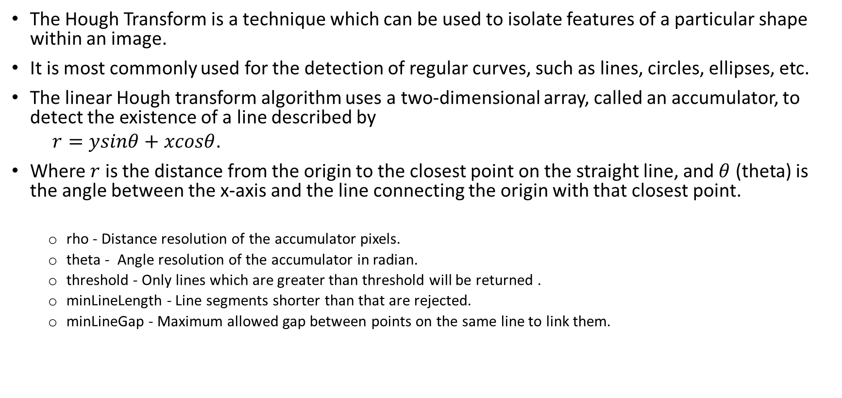
Hough Transformation
The Hough Transform is a technique which can be used to isolate features of a particular shape within an image.
It is most commonly used for the detection of regular curves, such as lines, circles, ellipses, etc.
The linear Hough transform algorithm uses a two-dimensional array, called an accumulator, to detect the existence of a line described by
$r=ysinθ+xcosθ$.
Where $r$ is the distance from the origin to the closest point on the straight line, and $θ$ (theta) is the angle between the x-axis and the line connecting the origin with that closest point.
rho - Distance resolution of the accumulator pixels.
theta - Angle resolution of the accumulator in radian.
threshold - Only lines which are greater than threshold will be returned .
minLineLength - Line segments shorter than that are rejected.
minLineGap - Maximum allowed gap between points on the same line to link them.
Notes:
This is the prime algorithm used in the project

Slide 11
Averaging & Extrapolating the Lane Lines
We will get multiple lines detected for each lane line.
We need to average all these lines and draw a single line for each lane line.
We also need to extrapolate the lane line to cover the full length line.
Notes:
Extrapolation is necessary to fill the gap between lines

Slide 12
Applying on video streams
Finally, our processing pipeline is ready to apply on video streams.
The output of the video streams will contains highlighted lane lines.

Slide 13
Programming Environment & Tools Used
Python-OpenCV 4.4.0.40
Python 3.7
Matplotlib
NumPy
JUPYTER-Notebook 6.0.0
Anaconda 2020.02
GitHub

Slide 14
References
International Journal of Computer Science and Mobile Computing IJCSMC, Vol. 3, Issue. 2, February 2014, pg.596 – 602
https://opencv.org/
https://www.python.org/
https://en.wikipedia.org/wiki/Canny_edge_detector
http://www.cs.unc.edu/~lazebnik/spring09/lec09_hough.pdf

Slide 15
Thank You !

